Slide 1
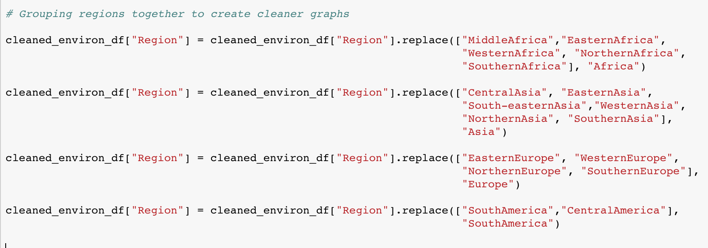
Cleaning My Data

Slide 2
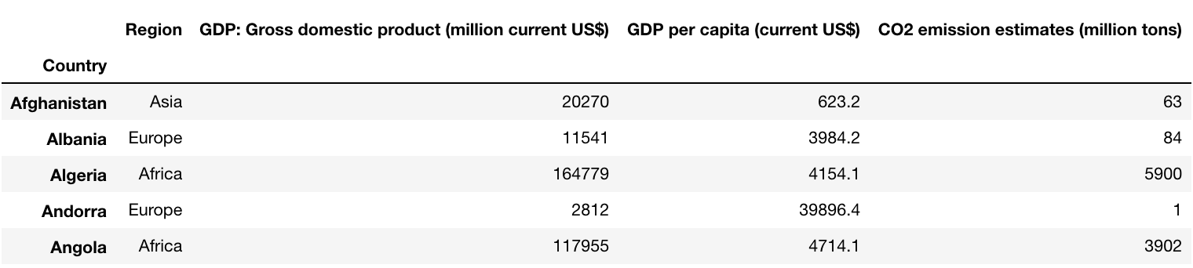
Cleaning My Data

Slide 3
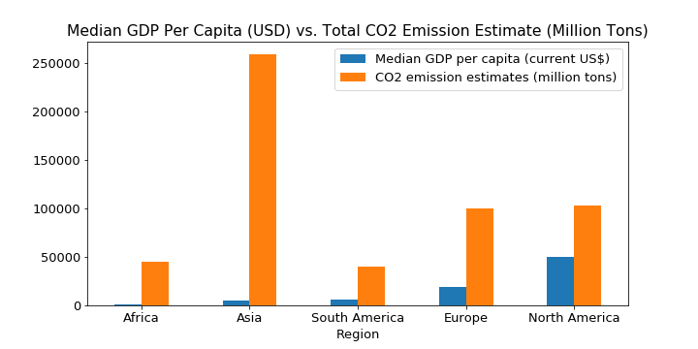
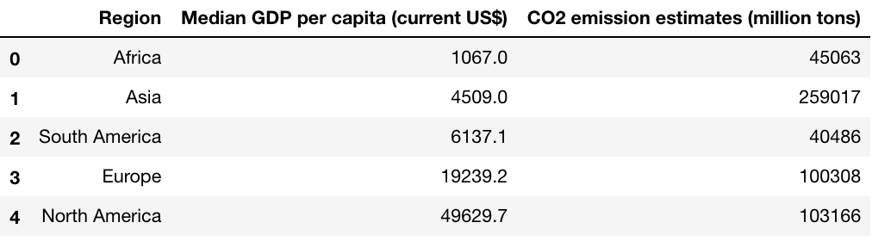
CO₂ Levels Relative to GDP by Region
The North American region has the highest median GDP per capita at $49,629.70 while Asia has the highest estimated CO₂ emissions at 259,017 million tons.
What does this tell us about how Carbon efficient a region is though?

Slide 4
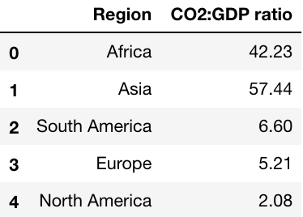
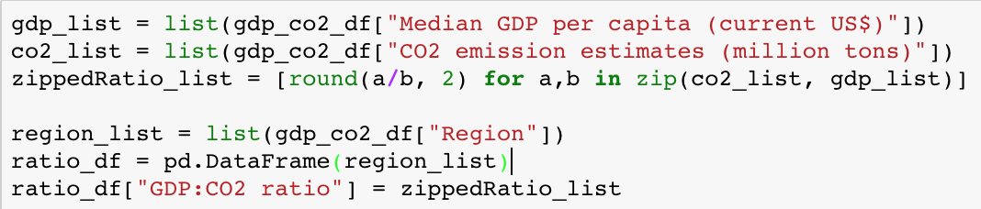
Utilizing List Comprehensions

Slide 5
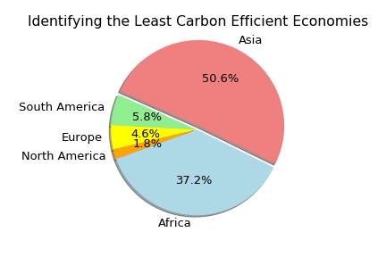
The Most Carbon Efficient Economies
Conclusion:
The North American region has the lowest CO2:GDP ratio, indicating that it has the most carbon efficient economy.
Asia has the least carbon efficient economy due to it’s high emissions.
Africa was second most inefficient due to it’s low median GDP per capita.

Slide 6
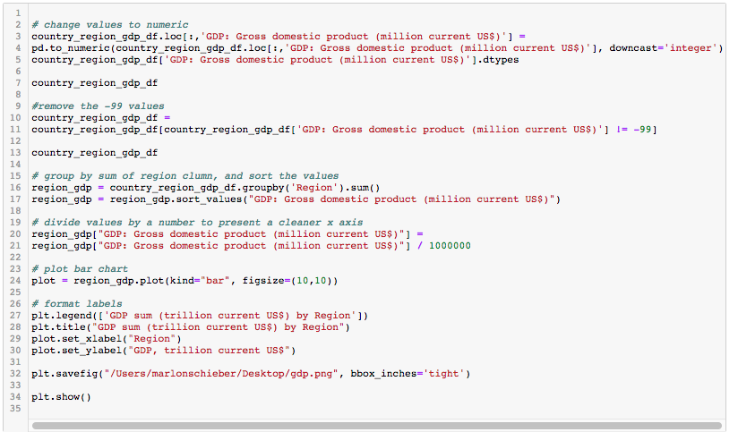
Total GDP, bar chart code

Slide 7
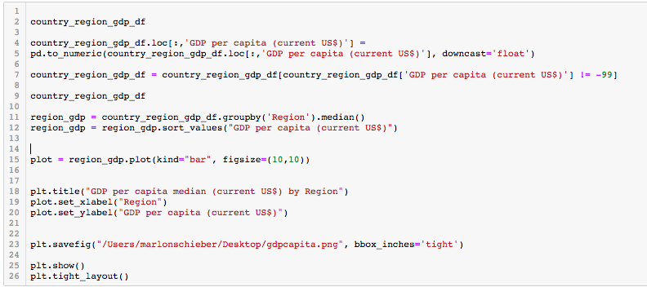
GDP per capita median, bar chart

